Slide 1
Cryptography

Slide 2
Understand and Apply Fundamental Concepts of Cryptography

Slide 3
High Work Factor
Work factor:
The average amount of effort or work required to break an encryption system
If the work factor is sufficiently high:
Encryption system is considered to be unbreakable, referred to as “economically infeasible” to break

Slide 4
Stream-Based Ciphers
Stream-based cipher:
When a cryptosystem performs its encryption on a bit-by-bit basis
Most commonly associated with streaming applications
Mixes the plaintext with a keystream that is generated by the cryptosystem

Slide 5
Stream-Based Cipher Rules
Keystream should not be linearly related to the cryptovariable
Statistically unpredictable
Statistically unbiased
Long periods without repetition
Functional complexity

Slide 6
Block Ciphers
Operate on blocks or chunks of text
Strong
Computationally intensive
Initialization Vectors (IV)

Slide 7
Basic Block Cipher Modes
Mode | How It Works | Usage
Electronic Code Book (ECB) | In ECB mode, each block is encrypted independently, allowing randomly accessed files to be encrypted and sitll accessed without having to process the file in a linear encryption fashion. | Any file with non-repeating blocks (less than 64 bits in length), such as transmission of a DES key or short executables.
Cipher Block Chaining (CBC) | In CBC mode, the result of encryption one block of data is fed back into the process to encrypt the next block of data. | Data at rest, such as stand-alone encrypted files on users’ hard drives.
Cipher Feedback (CFB) | In CFB mode, the cipher is used as a key-stream generator rather than for confidenti-ality. Each block of keystream comes from encrypting the previous block of ciphertext. | Retired due to the delay imposed by encrypting each block of keystream before proceeding.
Output Feedback (OFB) | In OFB mode, the keystream is generated independently of the message. | Retired due to Avalanche problems. Was uses in Pay-Per-View applications.
Counter(CTR) | Uses the formula Encrypt (Base+N) as a keystream generator where Base is a starting 64 bit number and N is a simple incrementing function. | Used where high speed or random access encryption is needed. Examples are WPA2 and the Content Scrambling System.
Mode | How It Works | Usage
Electronic Code Book (ECB) | In ECB mode, each block is encrypted independently, allowing randomly accessed files to be encrypted and sitll accessed without having to process the file in a linear encryption fashion. | Any file with non-repeating blocks (less than 64 bits in length), such as transmission of a DES key or short executables.
Cipher Block Chaining (CBC) | In CBC mode, the result of encryption one block of data is fed back into the process to encrypt the next block of data. | Data at rest, such as stand-alone encrypted files on users’ hard drives.
Cipher Feedback (CFB) | In CFB mode, the cipher is used as a key-stream generator rather than for confidenti-ality. Each block of keystream comes from encrypting the previous block of ciphertext. | Retired due to the delay imposed by encrypting each block of keystream before proceeding.
Output Feedback (OFB) | In OFB mode, the keystream is generated independently of the message. | Retired due to Avalanche problems. Was uses in Pay-Per-View applications.
Counter(CTR) | Uses the formula Encrypt (Base+N) as a keystream generator where Base is a starting 64 bit number and N is a simple incrementing function. | Used where high speed or random access encryption is needed. Examples are WPA2 and the Content Scrambling System.

Slide 8
Key Length
The size of a key
Goal is to make breaking the key cost more than the worth of the information or mission being protected and, if possible, not a penny more

Slide 9
Block Size
Produce a fixed length block of ciphertext
padding

Slide 10
Evaluation of Algorithms
Symmetric key encryption:
Only one key is used to encrypt and decrypt data
Asymmetric key encryption:
Used to solve the problem of key distribution
Two keys are used; private and public keys

Slide 11
Common Encryption Techniques
DES
3DES
RC2
Blowfish
AES
RC6

Slide 12
Encryption Algorithm Characteristics
Type
Functions
Key size
Rounds
Complexity
Attack
Strength

Slide 13
Hashing
Ideal cryptographic hash function is:
Easy to compute the hash value for any given message
Infeasible to generate a message that has a given hash
Infeasible to modify a message without changing the hash
Infeasible to find two different messages with the same hash

Slide 14
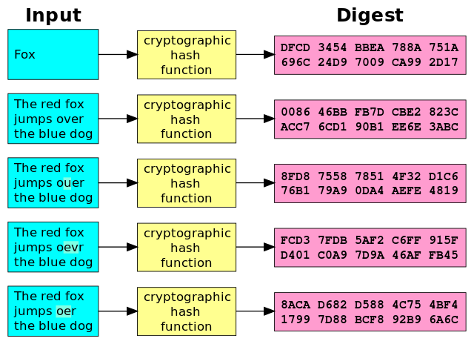
Cryptographic Hashing Function

Slide 15
Hashing Algorithms
Ideal cryptographic hash function is:
Message Digest (MD) – 128 bit output
Secure Hashing Algorithm (SHA-1) – 160 bit output
HAVAL – variable output
RIPEMD–160 – 160 bit output
No patent restrictions

Slide 16
Salting
Salt:
Random data that is used as an additional input to a one-way function that hashes a password or passphrase
Primary function of salts:
Defend against dictionary attacks and against pre-computed rainbow table attacks

Slide 17
Symmetric Cryptography
Operate with a single cryptographic key that is used for both encryption and decryption of the message
Fast, secure, cheap
Main problem is key management

Slide 18
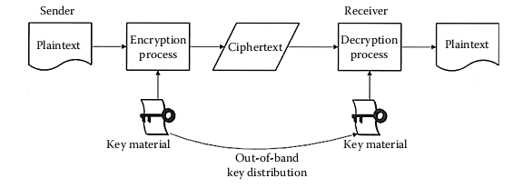
Out-of-Band Key Distribution

Slide 19
The Data Encryption Standard (DES)
The effective length of the DES key is 56 bits.
Because every bit has a possible value of either 1 or 0, the effective key space for the DES key is 256

Slide 20
Basic Block Cipher Modes
Electronic Codebook Mode
Cipher Block Chaining Mode (CBC)

Slide 21
The Stream Modes of DES
Cipher Feedback Mode
Output Feedback Mode
Counter Mode

Slide 22
Advantages and Disadvantages of DES
Advantages:
Strong
Fast
Disadvantages:
Not suitable for confidential information
Susceptible to brute-force attack

Slide 23
Triple DES (3DES)
Triple DES was designed to operate at a relative strength of 2112 using two different keys to perform the encryption
C = EK1(EK2(EK1(P)))

Slide 24
Advanced Encryption Standard (AES)
Rijndael algorithm
Obliged to:
Be flexible
Implementable on many types of platforms
Free of royalties

Slide 25
Counter Mode with Cipher Block Chaining Message Authentication Code Protocol (CCMP)
Encryption protocol that forms part of the 802.11i standard for wireless local area networks
Based on AES encryption using the CTR with CBC-MAC (CCM) mode of operation
128 bit keys
128 bit block size
48 bit IV to minimize replay attack vulnerabilities

Slide 26
Rijndael
The AES operation works on the entire 128-bit block of input data by first copying it into an array
The inputs are placed into the array by column so that the first four bytes of the input would fill the first column of the array

Slide 27
Additional Algorithms
IDEA
CAST
SAFER
BLOWFISH
TWOFISH
RC4 | RC5

Slide 28
RC4
Most widely used stream cipher
Uses a variable length key ranging from 8 to 2048 bits and a period of greater than 10100

Slide 29
Advantages and Disadvantages of Symmetric Algorithms
Advantages:
Fast
Secure
Confidential
Can be implemented at no cost to the user
Disadvantages:
Key management is difficult
Not able to provide non-repudiation

Slide 30
Asymmetric Cryptography
Provide an extensible and elastic framework in which to deploy cryptographic functions for:
Integrity
Confidentiality
Authentication
Non-repudiation

Slide 31
Asymmetric Algorithms
Asymmetric algorithms are one-way functions, that is, a process that is much simpler to go in one direction (forward) than to go in the other direction

Slide 32
Confidential Messages
Any message that is encrypted with a public key can only be decrypted with the corresponding other half of the key pair, the private key
As long as the key holder keeps her private key secure, there exists a method of transmitting a message confidentially

Slide 33
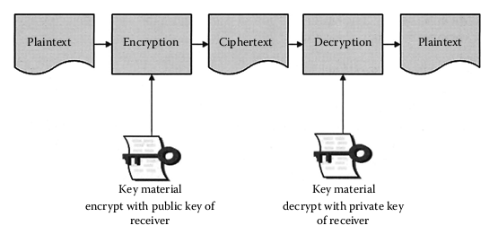
Using Public Key Cryptography to Send a Confidential Message

Slide 34
Open Message
Messages encrypted with the private key of a sender, can be opened or read by anyone with the corresponding public key
To send a message and provide proof of origin, encrypt it with your own private key
The recipient then has some guarantee that the message did, in fact, originate with the sender

Slide 35
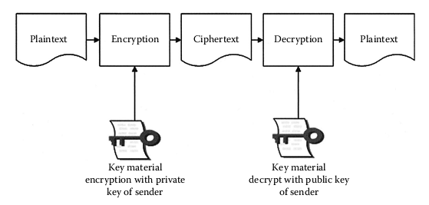
Using Public Key Cryptography to Send a Message with Proof of Origin

Slide 36
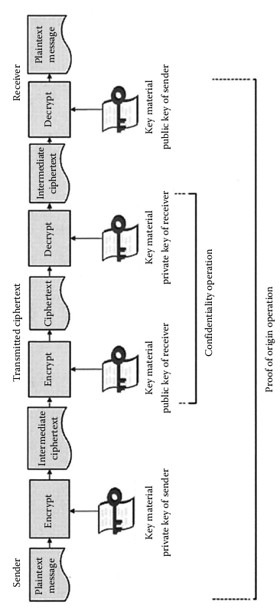
Confidential Messages with Proof of Origin

Slide 37
Diffie–Hellmann Algorithm
Key exchange algorithm
Enables two users to exchange or negotiate a secret symmetric key that will be used for message encryption

Slide 38
Advantages and Disadvantages of Asymmetric Key Algorithms
Advantages:
Allows you securely to send a message across an untrusted medium
Low overhead
Disadvantages:
Extremely slow
Impractical for everyday use
Ciphertext output may be much larger than the plaintext

Slide 39
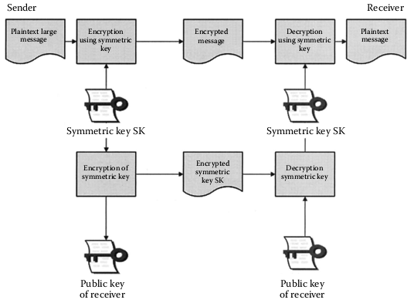
Hybrid Cryptography

Slide 40
Message Digests
Small representation of a larger message
Used to ensure the authentication and integrity of information not the confidentiality

Slide 41
Message Authentication Code (MAC)
A small block of data that is generated using a secret key and then appended to the message
Much smaller than the message generating it
Given a MAC, it is impractical to compute the message that generated it
Given a MAC and the message that generated it, it is impractical to find another message generating the same MAC

Slide 42
Chosen Plain-Text
To execute the chosen attacks, the attacker knows the algorithm used for the encrypting

Slide 43
Social Engineering for Key Discovery
Through coercion, bribery, or befriending people in positions of responsibility, spies or competitors are able to gain access to systems without having any technical expertise

Slide 44
Brute Force
Brute force is trying all possible keys until one is found that decrypts the ciphertext. This is why key length is such an important factor in determining the strength of a cryptosystem

Slide 45
Differential Cryptanalysis
Measures the exact execution times and power required by the crypto device to perform the encryption or decryption
By measuring this, it is possible to determine the value of the key and the algorithm used

Slide 46
Linear Cryptanalysis
Uses a linear approximation to describe the behavior of the block cipher
Given sufficient pairs of plaintext and corresponding ciphertext:
Bits of information about the key can be obtained
Increased amounts of data will usually give a higher probability of success

Slide 47
Rainbow Table
Map plaintext into a hash
One-way process
A rainbow table is a look-up table of sorted hash outputs

Slide 48
Ciphertext-Only Attack
One of the most difficult because the attacker has so little information with which to start
The attacker starts with is some unintelligible data that may be an important encrypted message
Becomes simpler when the attacker is able to gather several pieces of ciphertext and look for trends

Slide 49
Known Plaintext
The attacker has access to ciphertext and the plaintext versions of the same message
The goal is to find the link — the cryptographic key that was used to encrypt the message

Slide 50
Chosen Ciphertext
Chosen Ciphertext
Attacker has access to the decryption device and attempts to defeat the cryptographic protection by decrypting chosen pieces of ciphertext to discover the key
Adaptive chosen ciphertext
The attacker can modify the ciphertext prior to putting it through the algorithm

Slide 51
Dictionary Attack
Used most commonly against password files
Exploits the poor habits of users who choose simple passwords based on natural words

Slide 52
Replay Attack
Meant to disrupt and damage processing by sending repeated files to the host
If there are no checks or sequence verification codes in the receiving software, the system might process duplicate files

Slide 53
Factoring Attack
This attack:
Is aimed at the RSA algorithm
Attempts to find the keys through solving the factoring of these numbers

Slide 54
Understand Requirements for Cryptography

Slide 55
Protected Data Examples
Social Security number (SSN)
Credit card number or banking information
Passport number
Foreign visa number
Tax information
Credit reports
FERPA-protected information

Slide 56
Non-Sensitive Data Examples
Publicly available information
Information that would appear in the telephone directory
The last four digits only of a Social Security number or credit card number

Slide 57
Legislative and Regulatory Compliance
Safe harbor provisions:
A set of good faith conditions to be followed in order to protect the organization from penalties under a law

Slide 58
European Data Protection Directive
When processing is necessary for compliance with a legal action
When processing is required to protect the life of the subject
When the subject of the personal data has provided consent
When the processing is performed within the law and scope of “public interest”

Slide 59
Operate and Implement Cryptographic Systems

Slide 60
Public Key Infrastructure (PKI)
Publish public keys/certificates
Certify that a key is tied to an individual or entity
Provide verification of the validity of a public key

Slide 61
Functions of a CA
CA “signs” an entity’s digital certificate to certify the certificate content accurately represents the certificate owner
The functions of a CA may be distributed among several specialized servers in a PKI

Slide 62
Establishing Trust
Setting up a trusted public directory of keys
Public key certificate

Slide 63
X.509 Certification Issued by VeriSign
Field | Description of Contents
Algorithm Used for the Signature | Algorithm used to sign the certificate
Issuer Name | X.500 name of CA
Period of Validity | Start Date/End Date
Subject’s Public Key (algorithm, parameters, key) | Owner of the public key
Issuer Unique Identifier | Public key and algorithm used to create it
Subject’s Unique Identifier | Optional field in case the public key owner has more than one X.500 name
Extensions
Digital Signature of CA | Hash of the certificate encrypted with the private key of the CA

Slide 64
Advances in Key Management
Extensible Markup Language (XML)
XML Key Management Specification 2.0 (XKMS)

Slide 65
XML Key Management Specification 2.0
The two parts of the XML Key Management Specification 2.0:
XML Key Information Service Specification (X-KISS)
XML Key Registration Service Specification (X-KRSS)

Slide 66
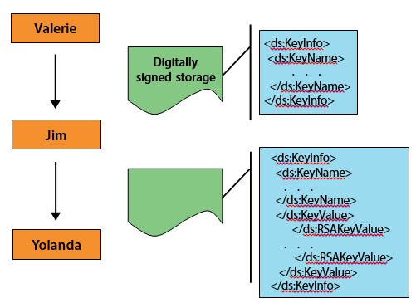
Example

Slide 67
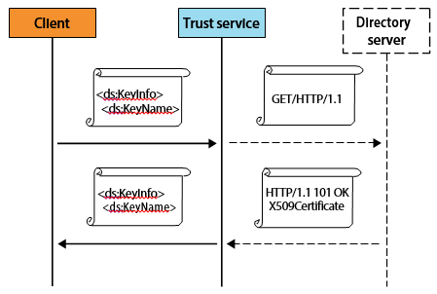
Example: SKMS Service Resolving a <ds: Retrieval Method> Element

Slide 68
Random
Pseudo randomness:
The quality of an algorithm for generating a sequence of numbers that approximates the properties of random numbers
Computers are so thoroughly deterministic that they have a hard time generating high-quality randomness

Slide 69
Generating a Two-Key Encryption Key Set
Generate a first pseudo random prime number
Generate a second pseudo random prime number
Produce a modulus
Generate a first exponent
Generate a second exponent

Slide 70
Key Length
Key length is the size of a key which a cryptographic algorithm used in ciphering or deciphering protected information
Keys control how an algorithm operates so only the correct key can decipher the information

Slide 71
Asymmetric Key Length
Asymmetric algorithm keys must be longer for equivalent resistance to attack than symmetric algorithm keys

Slide 72
Key Distribution
Keys can be distributed in a number of ways:
“Out-of-band” key exchange
The use of a Key Distribution Center (KDC) for key management requires the creation of two types of keys:
Master keys
Session key

Slide 73
Key Distribution Centers
The use of a Key Distribution Center (KDC) for key management requires the creation of two types of keys:
Master keys
Session key

Slide 74
Key Storage and Destruction
Trusted, tamperproof hardware security modules
Passphrase-protected smart cards
Key wrapping the session keys
Splitting cipher keys and storing
Protecting keys using strong passwords/passphrases
Key expiry

Slide 75
Key Storage and Destruction
All centrally stored data that is related to user keys should be signed
Backup copies should be made of central/root keys
Provide key recovery capabilities
Archive user keys for a sufficiently long crypto period

Slide 76
Factors Affecting Risk Exposure
The strength of the cryptographic mechanisms
The embodiment of the mechanisms
The operating environment
The volume of information flow
The security life of the data
The security function
The re-keying method

Slide 77
Factors Affecting Risk Exposure
The key update or key derivation process
The number of nodes in a network that share a common key
The number of copies of a key and distribution of those copies
The threat to the information

Slide 78
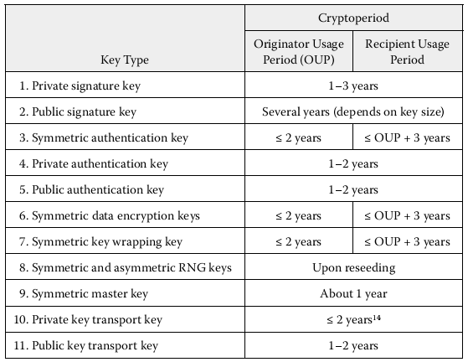
Recommended Crypto Periods for Key Types

Slide 79
Web of Trust
Used in PGP, GnuPG, and other OpenPGP-compatible systems
Establishes authenticity of the binding between a public key and its owner
Decentralized trust model

Slide 80
Secure Protocols
IP Security (IPSec) is a suite of protocols for communicating securely with IP by providing mechanisms for authenticating and encryption

Slide 81
Authentication Header (AH)
The authentication header is used to prove the identity of the sender and ensure that the transmitted data has not been tampered with

Slide 82
Encapsulating Security Payload (ESP)
The encapsulating security payload encrypts IP packets and ensures their integrity

Slide 83
Encapsulating Security Payload (ESP)
ESP header
ESP payload
ESP trailer
Authentication

Slide 84
Internet Key Exchange (IKE)
Internet key exchange allows communicating partners to prove their identity to each other and establish a secure communication channel

Slide 85
Secure Socket Layer/Transport Layer Security (SSL/TLS)
SSL/TLS is primarily used to encrypt confidential data sent over an insecure network such as the Internet

Slide 86
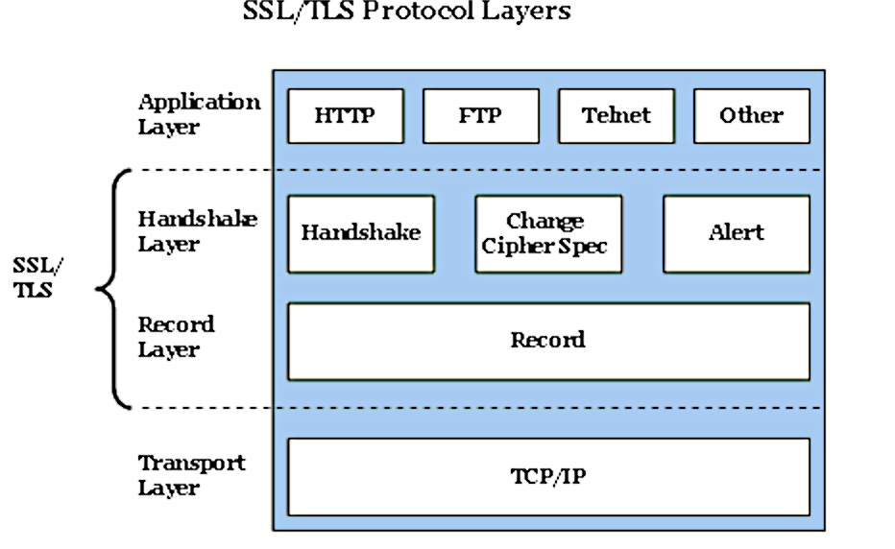
SSL/TLS Protocol Layers

Slide 87
Encryption
SSL/TLS uses:
Symmetric key and asymmetric key encryption
Public key encryption to authenticate the server to the client and optionally the client to the server

Slide 88
Hash Algorithms
Hashing is used to establish data integrity during transport.
Two common hash algorithms are:
Message Digest 5 (MD5)
Standard Hash Algorithm 1 (SHA-1)

Slide 89
Benefits of SSL/TLS
Strong authentication, message privacy, and integrity
Interoperability
Algorithm flexibility
Ease of deployment
Ease of use

Slide 90
Secure/Multipurpose Internet Mail Extensions (S/MIME)
Widely accepted method for sending digitally signed and encrypted messages
Allows you to encrypt e-mails and digitally sign them
S/MIME provides two security services:
Digital signatures
Message encryption

Slide 91
Process for Digitally Signing an E-Mail
Message is captured
Information uniquely identifying the sender is retrieved
Signing operation is performed on the message
Digital signature is appended to the message
Message is sent

Slide 92
Process for Verifying a Digital Signature of an E-Mail Message
Message is received
Digital signature is retrieved from the message
Message is retrieved
Information identifying the sender is retrieved
Signing operation is performed on the message
Digital signature included with the message is compared to digital signature produced on receipt
If the digital signatures match, the message is valid

Slide 93
Process for Encryption of an E-Mail Message
Message is captured
Information uniquely identifying the recipient is retrieved
Encryption operation is performed on the message using the recipient's information to produce an encrypted message
Encrypted message replaces the text in the message
Message is sent

Slide 94
Process for Decrypting an E-Mail Message
Message is received
Encrypted message is retrieved
Information uniquely identifying the recipient is retrieved
Decryption operation is performed on the encrypted message using the recipient's unique information to produce an unencrypted message
Unencrypted message is returned to the recipient

Slide 95
Process of Digitally Signing and Encrypting an E-Mail Message
Message is captured
Information uniquely identifying the sender is retrieved
Information uniquely identifying the recipient is retrieved
Signing operation is performed on a message using the sender's unique information to produce a digital signature

Slide 96
Process of Digitally Signing and Encrypting an E-Mail Message
Digital signature is appended to the message
Encryption operation is performed on the message using the recipient's information to produce an encrypted message
Original message is replaced by encrypted message
Message is sent

Slide 97
Process of Decrypting an E-Mail Message and Verifying a Digital Signature
Process of Decrypting an E-Mail Message and Verifying a Digital Signature
Message is received
Encrypted message is retrieved
Information uniquely identifying the recipient is retrieved
Decryption operation is performed on the encrypted message using the recipient's unique information to produce an unencrypted message

Slide 98
Process of Decrypting an E-Mail Message and Verifying a Digital Signature
Unencrypted message is returned
Unencrypted message is returned to the recipient
Digital signature is retrieved from the unencrypted message
Information identifying the sender is retrieved
Signing operation is performed on the unencrypted message using the sender's information to produce a digital signature

Slide 99
Process of Decrypting an E-Mail Message and Verifying a Digital Signature
Digital signature included with the message is compared against the digital signature produced on receipt
If the digital signatures match, the message is valid

